Slide 1
Customer Needs, Engineering Requirements, and Background
Winiecki Renewable Energy Project
Michael Horn, Garrett Cornelius, Nicholis Santana & Issac Granados
ME 476C
Dr. Carson Pete
Northern Arizona University
Department of Mechanical Engineering

Slide 2
Project Description
Winiecki Off Grid Renewable Energy Project
BackGround:
Private party off grid cabin to be constructed by Winiecki family
Construction plans are already in place
Site location established
Energy implementation is required
Project Goals:
Analyze and model a solar photovoltaic system for off grid application
Model estimated energy load/ consumption of the Winiecki off grid cabin
Prototype and test thermal properties of cabin
Optimize solar system for maximum efficiency
Implement and install selected solar design in person
Michael Horn
03/8
Winiecki Renewable Energy

Slide 3
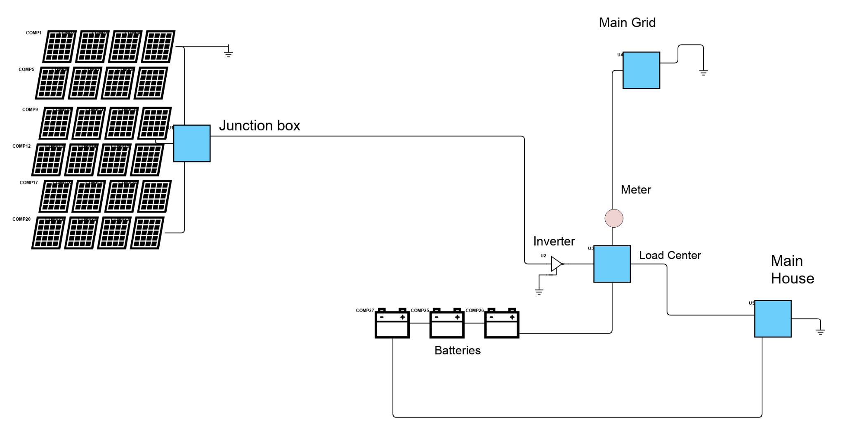
Basic Electrical Diagram
Michael Horn 03/8
Winiecki Renewable Energy

Slide 4
Background & Benchmarking
Garrett Cornelius 03/10/2023
Winiecki Renewable Energy

Slide 5
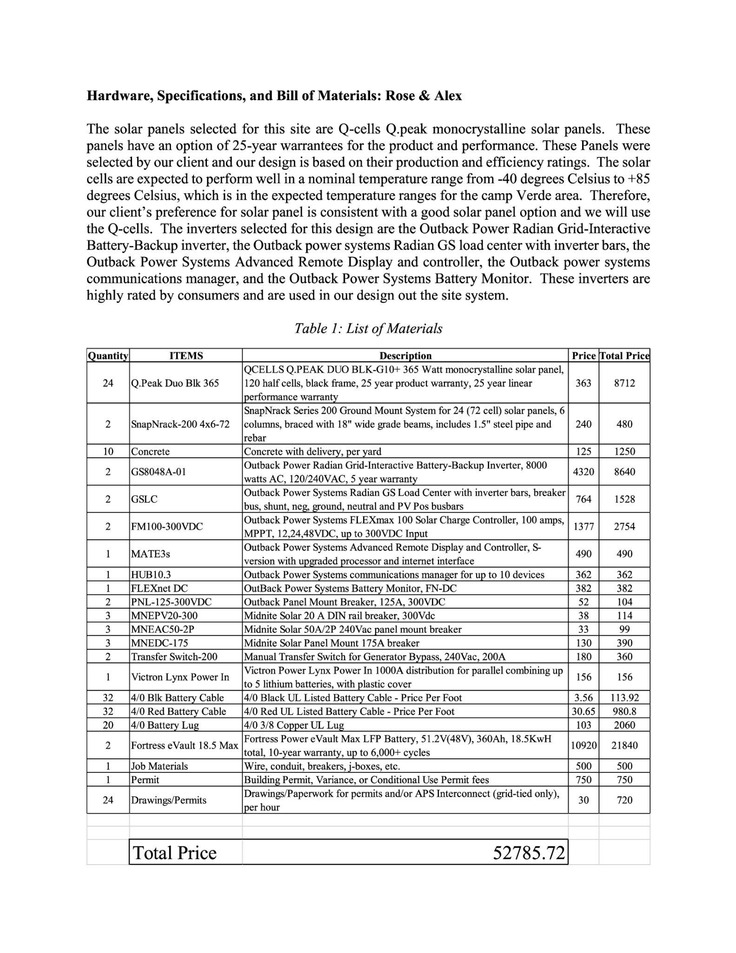
Early Project Development
5 Students from ME 451 Renewable Resources wrote a report on the project
Topics Included BOM, Location, Return on Investment, Timelines etc.
Total Price of their system: ~ $53,000
No labor and design costs included
Garrett Cornelius 03/10/2023
Winiecki Renewable Energy

Slide 6
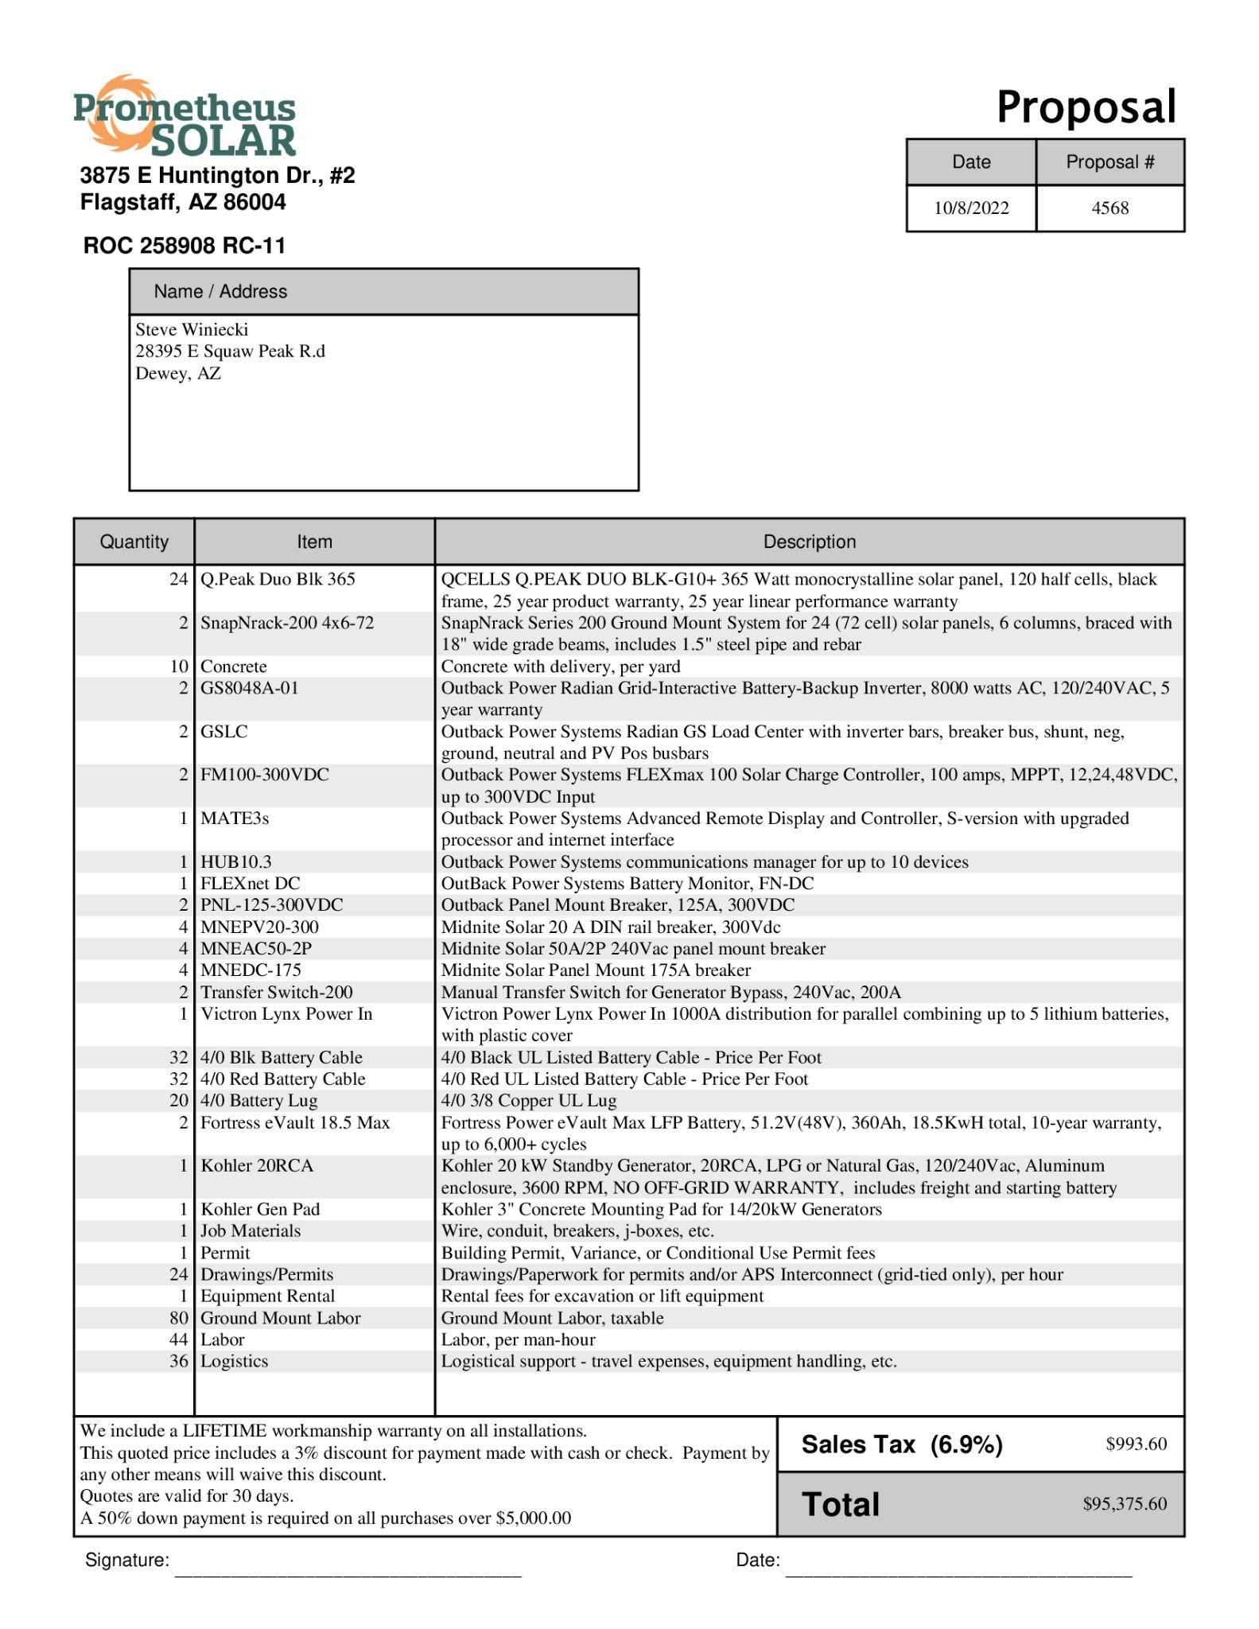
Early Project Development
Cont.
Quote from Prometheus Solar
8.8 kW system with 2 battery Inverters
Includes Permits, Labor, Equipment, Logistics etc.
Quote Total : $95,375
Garrett Cornelius 03/10/2023
Winiecki Renewable Energy

Slide 7
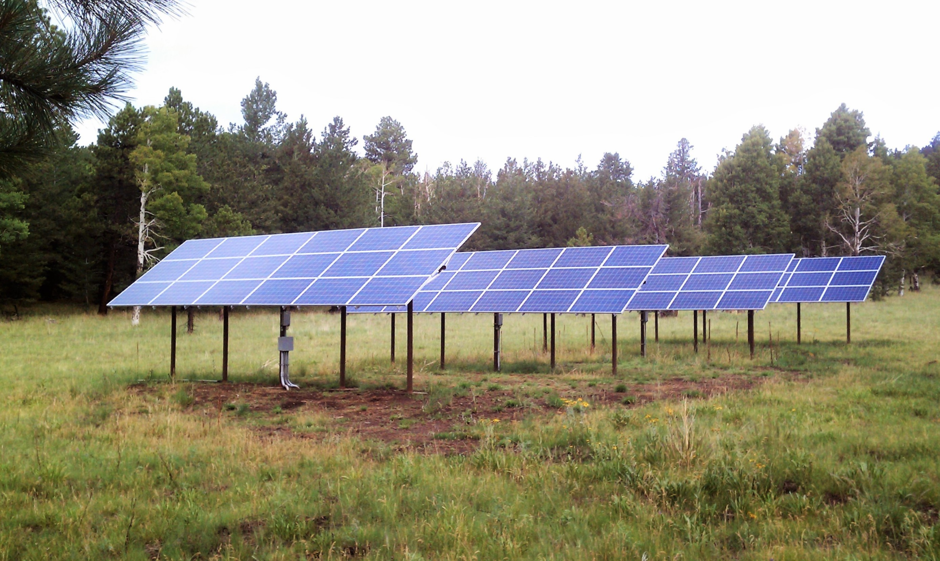
Applicable Solar Configuration
Ground Mounted Systems
Ideal for Rural Areas
More Efficient
Easier Access
Eliminates Dependency on House Construction
Garrett Cornelius 03/10/2023
Winiecki Renewable Energy
Photo Source [1] : https://prometheussolar.com/off-grid/

Slide 8
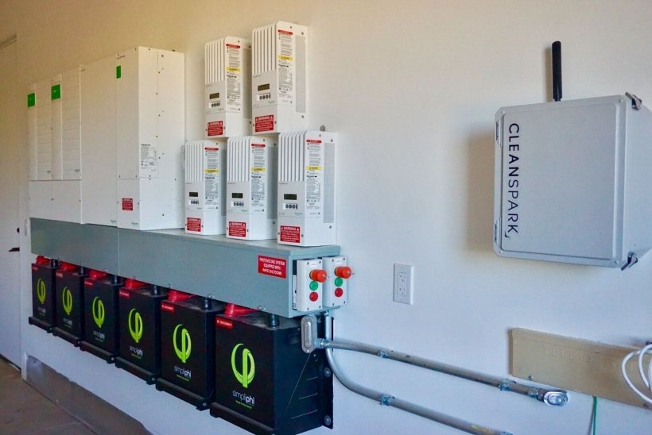
Applicable Solar Configuration Cont.
Battery Storage Systems
Allows for energy storage
Enables Off Grid and Emergency Use
Increases cost
Additional maintenance may be required
Garrett Cornelius 03/10/2023
Winiecki Renewable Energy
Photo Source [2] : https://www.energy.gov/eere/solar/articles/should-i-get-battery-storage-my-solar-energy-system
Notes:
https://www.energy.gov/eere/solar/articles/should-i-get-battery-storage-my-solar-energy-system

Slide 9
Literature Review:
Financials
Garrett Cornelius 03/10/2023
Winiecki Renewable Energy

Slide 10
The Current Cost of Electricity
Cost per KWh in Camp Verde, Arizona : 11.96 Cents
Average Yearly Usage of a 2000 sq. ft. home : 18,000 KWh
Yearly Cost : $2,160
Cost over 30 years : ~$65,000
Garrett Cornelius 03/10/2023
Winiecki Renewable Energy
Information Source [3] : https://www.electricitylocal.com/states/arizona/camp-verde/
Notes:
https://www.electricitylocal.com/states/arizona/camp-verde/

Slide 11
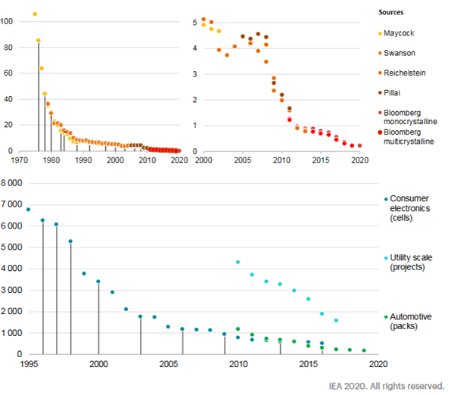
PV Solar Developments
Greater Efficiency with technological advancements
Advancements continue throughout time
USDA - Capital Costs have decreased 63 % since 2010 for residential scale projects
Garrett Cornelius 03/10/2023
Winiecki Renewable Energy
Graphic Source [4] : https://www.iea.org/reports/clean-energy-innovation
Information Source [5] : https://www.usda.gov/sites/default/files/documents/renewable-energy-trends-2020.pdf

Slide 12
Federal Tax Credits
With the signing of The Inflation Reduction Act Of 2022, the ITC was renamed the Residential Clean Energy Credit, the value was increased to 30%, and the deadline was extended through December 31 of 2034
The Residential Clean Energy Credit can be rolled into future tax filings
Garrett Cornelius 03/10/2023
Winiecki Renewable Energy
Information Source [6] : https://palmetto.com/learning-center/blog/everything-you-need-to-know-about-the-solar-tax-credit

Slide 13
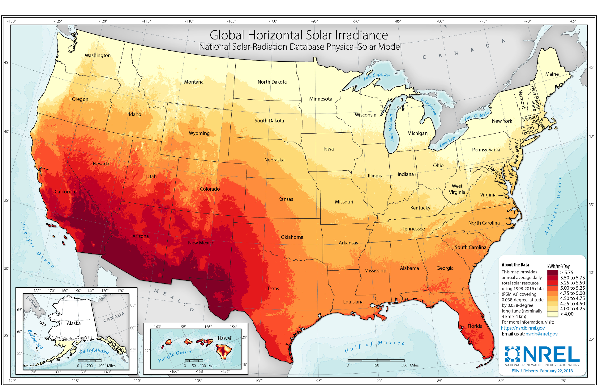
Arizona State Tax Credits
Arizona has some of the highest solar energy potential in the US
Energy production may range between 5 and 6 kwh per square meter
Garrett Cornelius 03/10/2023
Winiecki Renewable Energy
Information and Photo Source [5] : https://www.usda.gov/sites/default/files/documents/renewable-energy-trends-2020.pdf

Slide 14
Arizona State Tax Credits
Arizona law provides a solar energy credit for buying and installing a solar energy device at 25% of the cost, including installation, or $1,000, whichever is less. [7]
A solar power installation greatly increases the value of your home and property. In Arizona, solar panels are eligible for a property tax exemption. [8]
Garrett Cornelius 03/10/2023
Winiecki Renewable Energy
Information Source [7] , [8]: https://azdor.gov/forms/tax-credits-forms/credit-solar-energy-credit, https://palmetto.com/learning-center/blog/arizona-solar-incentives

Slide 15
Literature Review:
Energy Modeling

Slide 16
Whole-Building Energy Modeling (BEM)
BEM is physics-based software simulation of building energy use
A BEM program takes as input a description of a building including geometry, construction materials, location, weather and electrical components
Inputs are combined to calculate thermal loads, system response to those loads, and resulting energy use, along with related metrics like occupant comfort and energy costs.
Projects using BEM software show a 22% increase in efficiency
Garrett Cornelius 03/10/2023
Winiecki Renewable Energy
Information Source [9] https://www.energy.gov/eere/buildings/about-building-energy-modeling

Slide 17
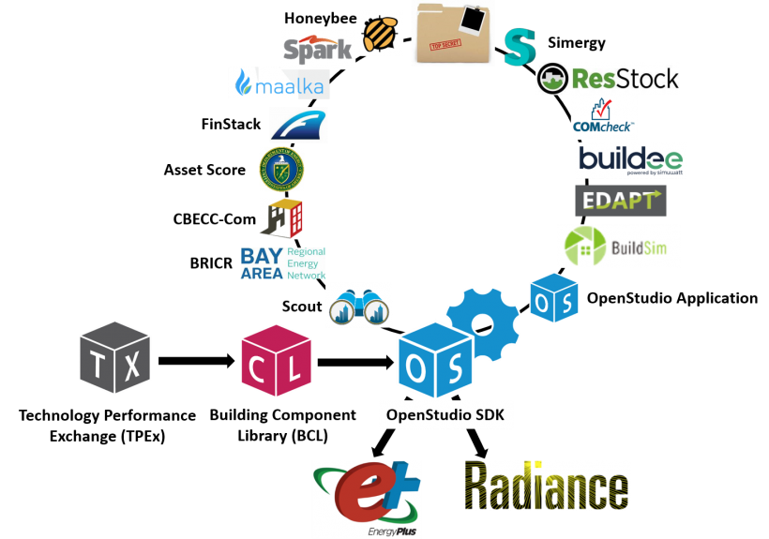
U.S. DOE Modeling Engine : Energy Plus
EnergyPlus™ is a whole building energy simulation engine and program for Industry and Residential Use
Used to implement and test federal energy standards and regulations
$83,300,000 funding to date
Expected to save 800 Trillion BTU’s by 2030
Garrett Cornelius 03/10/2023
Winiecki Renewable Energy
Information and Graphic Source [10] : https://www.energy.gov/eere/buildings/articles/energyplus

Slide 18
Customer Needs & Engineering Requirements

Slide 19
Customer Needs
3 Day Battery storage system required without using the grid
75 Kilowatts generated per month for the 24 solar panel taking into account the in house shop all based on the final report we were given
Inverter option between grid and off system
Safety and accessibility to control
Efficiency
Issac Granados
3/8
Winiecki Renewable Energy

Slide 20
Engineering Requirements
Excess energy storage using batteries
Ability to power home at max capacity during daytime, limited capacity at night
Ability to connect/ disconnect to grid at user discretion
Safe and reliable operating system
Maximization of efficiency
Issac Granados
3/8
Winiecki Renewable Energy

Slide 21
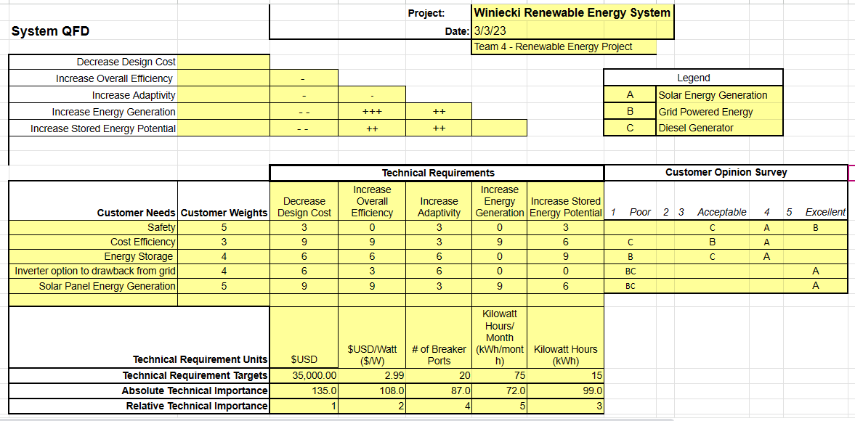
Issac Granados
3/8
Winiecki Renewable Energy

Slide 22
Schedule & Budget

Slide 23
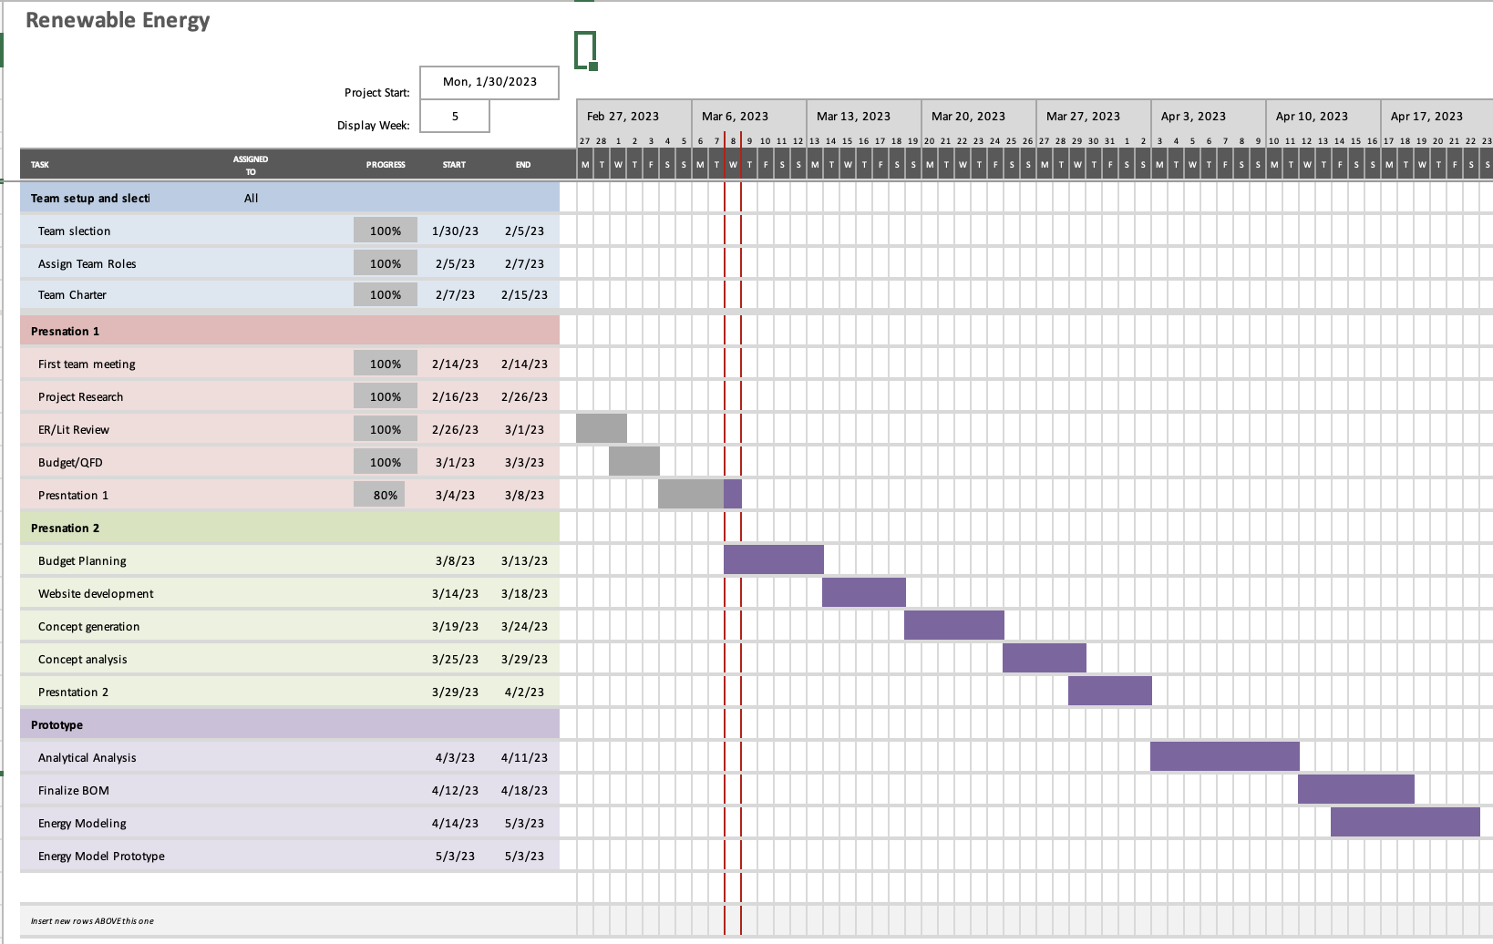
Nicholis Santana s 03/8/2023
Winiecki Renewable Energy

Slide 24
Budget
Private party client with no preallocated, fixed budget
Budget will range between $25,000 and $35,000, depending on client needs
The most cost effective, competitive quotes will be sought
Nicholis Santana 03/08/2023
Winiecki Renewable Energy

Slide 25
Moving Forward

Slide 26
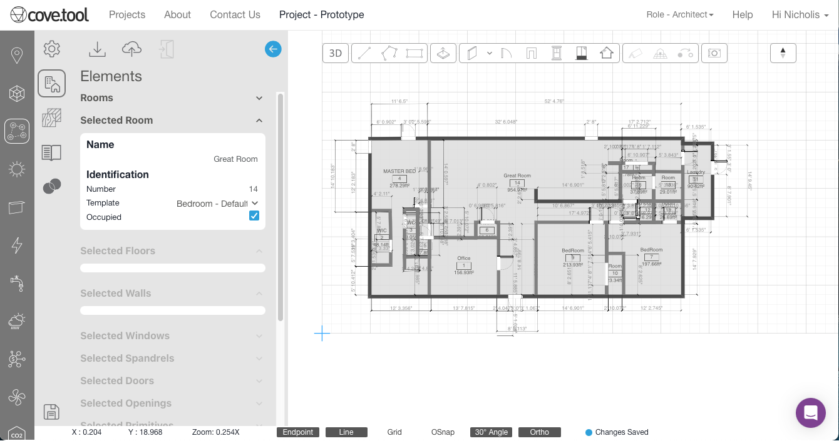
Basic Energy Model schematic
Nicholis Santana s 03/8/2023
Winiecki Renewable Energy

Slide 27
Citations
Photo Source [1] : https://prometheussolar.com/off-grid/
Photo Source [2] : https://www.energy.gov/eere/solar/articles/should-i-get-battery-storage-my-solar-energy-system
Information Source [3] : https://www.electricitylocal.com/states/arizona/camp-verde/
Graphic Source [4] : https://www.iea.org/reports/clean-energy-innovation
Information Source [5] : https://www.usda.gov/sites/default/files/documents/renewable-energy-trends-2020.pdf
Information Source [6] : https://palmetto.com/learning-center/blog/everything-you-need-to-know-about-the-solar-tax-credit
Information Source [7]: https://azdor.gov/forms/tax-credits-forms/credit-solar-energy-credit
Information Source [8]:https://palmetto.com/learning-center/blog/arizona-solar-incentives
Information Source [9] https://www.energy.gov/eere/buildings/about-building-energy-modeling
Information and Graphic Source [10] : https://www.energy.gov/eere/buildings/articles/energyplus

Slide 28
Questions?

